Slide 1
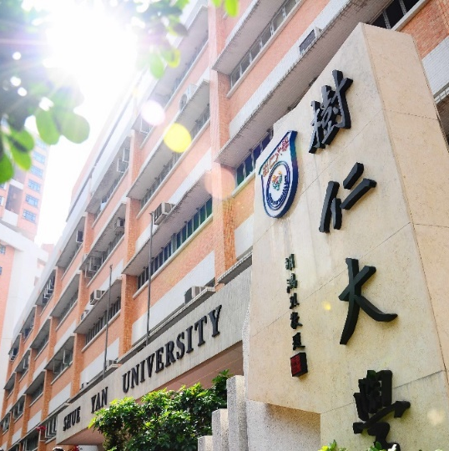
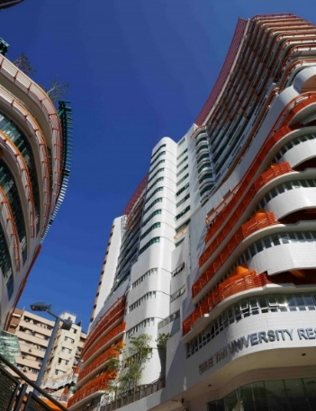
2022-23 年度
升四年級同學修科指引
(四年共修124學分畢業)

Slide 2
 |  |  | Credits
Compulsory Courses
Departmental Core Requirements: |  |  | 3/6
SOC. OR SOC. | 400 401-2 | Senior Seminar Honours Project (for students whose GPAs are 3.0 or above)
Concentration Departmental Elective Courses (Choose 6 credits according to your chosen concentration) |  |  | 6
Culture, Heritage and Innovation
SOC. | 409 | Collective Memory and Social Change
SOC. | 413 | Digitized Media, Culture and Society
SOC. | 414 | Heritage Studies: Critical and Innovative Dimensions
SOC. | 415 | Film, Television and Society
Entrepreneurship and Community
BUS. | 480 | Business Ethics and Corporate Social Responsibility
SOC. | 411 | Impact of Social and Enterprise Innovation
SOC. | 412 | Contemporary Consumer and the Changing Community
Non-concentration Departmental Elective Courses (Choose 12 credits for Senior Seminar mode; Choose 9 credits for Honours Project mode) |  |  | 12/9
SOC. | 380 | Arts and Everyday Life in the Digital Era
SOC. | 359 | Self, Emotion and Culture
SOC. | 403 | Globalization and Inequality
SOC. | 406 | Selected Topics
SOC. | 410 | Sociology of Organizations
SOC. | 420 | Evaluation Research
SOC. | 430 | Economic Reform and Social Transformation in Contemporary China
SOC. | 440 | Collective Behaviour and Social Movements
SOC. | 490 | Work Placement
Total Credits |  |  | 21
*The Departmental Elective Courses offered will be subject to change.

